Slide 1
Session 2.1 Conceptual Modelling
IN705 Databases 3 - 2018
Notes:
Based on Churcher, chapters 3-6

Slide 2
Useful References
Churcher, Clare (2007) ,Beginning Database Design, From Novice to Professional. Apress.
Simsion, G.C. & Witt, G.C. (2005), Data Modelling Essentials. Elsevier.
Notes:
Some of the examples we will look at today come from these two books.
They are both excellent, in-depth treatments of the modelling process.

Slide 3
Required Reading
Churcher
Chapters 3 & 4
http://proquestcombo.safaribooksonline.com/book/databases/database-design/9781430242093

Slide 4
Purpose
To develop a formal representation of the problem space our database represents.
This representation is independent of any logical model, language or DBMS.
Notes:
For example, we are going to be translating it into a relational schema (i.e. Tables) because we are using a relational DBMS this term (SQL Server).
We could, however, choose to translate it into XML for more convenient delivery over the web. Or into an object-oriented system, because we like those.

Slide 5
Basically…
Understand the problem
Identify the things (entities), their attributes, and the relationships between them
Draw the diagram
Notes:
Right, you’ve done this before
In fact….

Slide 6
But We Did This in DB2....
We do it again because
It is difficult
Is it not automatic or mechanical
It is critically important to the quality of the final product
We will look at some of the more advanced issues in the process.
Notes:
I know you did, but we have to do it again.
And, if you go into database design, again and again and again
Of all the topics we will cover this term, this is the hardest one. Because it is the one that takes creativity
There is no Wizard to click through like in DBA, no mechanical set of steps to follow like in logical design.
This one is an art, and it takes practice – a lot of it.
Also, if you screw up the model, it doesn’t matter how many subqueries deep you can go, you won’t be able to get the knowledge out.
Also, for the code monkeys, the process you go through to build a data model is very similar to the process you go through to build a class architecture. Practicing either will help you do the other better.
We assume that you know the basics, and we will this time be able to look at some of the more subtle and complex aspects of the process

Slide 7
What Can Go Wrong
Data integrity can be affected
Performance (speed) can be hurt
The system can be rigid
Blocked or deadlocked transactions can occur
Functional requirements can go unsatisfied
Notes:
If you build a database from a bad model:
Data Integrity
Data integrity means that all your data values are in the correct domain, all constraints are implemented, all values are correct, etc.
Not getting your constraints right is an obvious risk error, as it not normalising correctly (we’ll see what this is formally later, but informally, it’s making sure that you only store each value once, so you never have two that can get out of sync)
But even something as seemingly minor as not choosing your field names right can give you problems if, for example, you use the wrong terminology, causing data entry errors later on
Performance
A poorly constructed model can result in query problems, where you don’t have the structure you need to answer the questions the client wants to ask.
This can slow things down considerably
If it gets bad enough, it may be a matter of “impossible”, not just slow
Rigid
Rigid = not scalable, can’t handle change gracefully. If you’re really writing software that’s supposed to be useful to a long time (as opposed to just until you get your marks back) that’s not good enough
We’ll talk about locking in a couple of weeks….

Slide 8
What Can Go Wrong
“Although you can achieve performance gains by retrofitting a database with various types of indexes and more powerful hardware, you can never completely compensate for a bad data model. “
Poolet, 2005

Slide 9
What Can Go Wrong
“I’ve personally served as an expert witness in several court trials where plaintiffs sued defendants for serious financial remuneration when custom database applications had performance and/or data accuracy problems. In every case, there was a failure to data model the business requirements. Thus, the data effectiveness suffered. … No amount of coding could overcome the resulting bad database design. So, in every case, the plaintiff won. “
Scalzo, 2009
Notes:
http://www.information-management.com/infodirect/2009_123/data_modeling_databases_management-10015423-1.html?ET=informationmgmt:e972:2178170a:&st=email

Slide 10
Remember...
For a given context, there is no “perfect” conceptual model.
“It is never possible to say that a given data model is the correct one. We can only say that it meets the requirements of a problem within a given scope, and subject to certain assumptions or approximations.”
- Churcher
Notes:
One of the reasons for, and consequences of this subjectivity is that there is no right answer
Different people will produce different models
Some aspects of reality will have to be omitted or fudged because they are not pertinent to the problem we are solving
And the appropriate model for the same data context will be different depending on what the user wants to do with their database.
Always keep this in mind: The goal is to turn data into information. Specifically, the information your client is looking for.

Slide 11
Process Overview
Requirements Elicitation
Identifying the Entities
Modelling the Attributes and Relationships
Verifying the Model
Notes:
You will note that there is no discussion here of eliminating redundancy or resolving many-to-many relationships.
These are issues in the next step of the process – logical modelling – where we will take our ERD and make it into tables
In this advanced course, we will take a formal approach to that process called “normalisation”, that will introduce rigour into our development cycle.
But we don’t worry about it here in the Conceptual Modelling stage. This is about getting an entity-relationship representation of our data universe, to the level of detail necessary to solve the client’s problem.
Note that this is only one SDLC that is used. There are others where, for example, the data model is converted into a relational schema prior to verification (which is done with the client)
However, some authors have argued, convincingly to me, that it is easier for the client to understand an ERD than to understand a bunch of normalised tables.

Slide 12
1. Requirements Elicitation
Determining
What data the model represents
How the data will be used
Usually accomplished by talking to the client
Notes:
If you do databases for a living, you will be building systems about all kinds of data universes, some of which you won’t know anything about.
That, of course, won’t work, so the first step is always this: find out what the thing is supposed to do
We do this, as we do any early product design, by talking to the client and, ideally, to the users
Problem is this: Have you ever tried talking to a user? It’s confusing. They find it hard to articulate what they want, they can’t understand you when you speak geek, and generally the situation is fraught and error prone if you view it as “talk to the user”
Like all software engineering flavoured things, it works better if you have an organised process, and many have been developed that can be shown to facilitate the elicitation step.
The one we are going to discuss is “use case”
This method will be helpful to you for any software dev with clients, db or not, including Project
Use cases: What might people want to do with these data?
Understand what tasks all the people who will use the system need to carry out (the Sports Team example, with “ignoring fill-ins if the database is for getting in touch with team members in the event of a cancellation” is a good one here. The issue isn’t “what might one ever do in this data universe” it is “what does this client want this database for”)
Figure out what data you will need to store in order to support those tasks.
Questions to guide:
What does the user do (that involves the data we’re working with)
What data is involved
What is the objective of the system
What data is required to satisfy the objective
What are the input use cases
What are the output use cases

Slide 13
Use Cases
Semi-formal methodology for figuring out how a system will be used
Associated notation that facilitates communication between designers and clients.
Notes:
“Use Cases” is formally a part of the UML system, but it’s really just an organised approach to figuring out how a system is going to be used

Slide 14
Use Cases
Process
Through discussion and observation, identify what tasks all the people who will use the system need to do.
Figure out what data you will need to store in order to support those tasks.
Make a clear diagram of your plan.
Present the diagram to the client for discussion.
Repeat......

Slide 15
Example
Player
Team
Plays For
Name
Address
Phones
Name
Grade
Captain
1..n
0..1
Notes:
Here is a version of the desperately done-to-death Sports Team database (based on an example in Churcher)
You have Players and you have Teams.
Each Player plays for 0 or 1 team (some people may have joined the club but not be on a team yet)
Every Team has 1 or more Players.
Say the client tells you s/he wants this database to hold information about the matches played between teams and the scores and so on.
Any entities you think you might want to add? Match perhaps?
How does recording data about matches impact your Player entity? => You have to keep track of which team each player is on
Maybe you add a Team foreign key to your Player entity. That will work.
But…
What do you do in your model about fill-ins? Bob usually plays for Team A and Fred for Team B.
But for Tuesday’s match, Fred was sick so Bob filled in for him.
So who are the members of Team B? Does this include Bob?
And what team does Bob play for? What is the value of his Team foreign key? Is it Team A or Team B? Both? (Which you can’t do in a single attribute, of course.)

Slide 16
Example (continued)
Two choices
Extend the model so that you can represent accurately the situation where Bob fills in for Fred during Tuesday’s match.
Ignore it
Notes:
Option 1 would involve representing a 3-way relationship between Team, Player and Match, which, if you recall your table-making experience, involves a bunch of table and foreign keys
Option 2 . Bob is usually on Team A, so just record that. Ignore the fact that one time he played for Team B.
This involves no extra work.
The downside, of course, is that you can’t store/discover/use the fact that Bob filled in for Fred on Tuesday
So which is right?
Answer => It depends.

Slide 17
Example (continued)
So how do you decide?
It depends on how the client wants to use the database
Don’t ask “What might one ever do in this data universe?”
Ask “What does this client want this database for?”
Notes:
This is not a question with a single correct technical answer.
It depends, as so many things do in database development, on what information/knowledge/truth the client wants to work with.
It depends on how the client wants to use the database. SO YOU NEED TO FIND THIS OUT.
With database work we try to balance delicately future expansion with current need.
It is generally not possible to maintain the kind of scalability in Db work that you can in application work. We tend, therefore, to go for realistic current and short-term future functionality.
Ask your client: Why do you want to know who is on what team?
If they say “So we can send out the match schedule at the beginning of the season” or “So we can get in touch with them in case of a cancellation” clearly, they don’t care about fill-ins.
So you skip it.
What answer(s) might cause you to go for Option 1?
Keeping personal stats
Recording numbers of fill-ins
…..

Slide 18
Questions to Guide You
What does the user do?
What data are involved?
What is the objective of the system?
What data are required to satisfy the objective?
What will be input?
What will be output?
Notes:
Ask yourself these....
And 1000s more.
Learning to figure out what clients want takes practice.
You worked on this in software engineering
Your 3rd year project depends on it

Slide 19
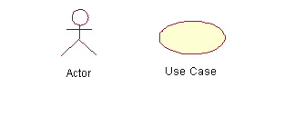
Use Case Diagrams
Diagram
Detailed written description
Notes:
Remember the second step was to draw a diagram to show the user your plan
You will need to produce this type of diagram for your first assignment
UML-style use case diagrams look like this.
There are very strict rules, but don’t get bonkers about it.
Just do what’s needed to make your plan clear to your client
It’s more important to think thoroughly and completely than to get all finicky about the symbol rules.
These are the two basic elements of a use case diagram – the person doing something (called an actor) and the thing they’re doing (called, confusingly, a “use case”)
In addition to the diagram, each Use Case has a written description that details exactly what you mean. This is a very important part of the technique. More important than the little symbols, really.

Slide 20
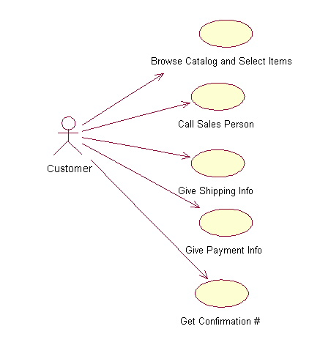
Simple Use Case Diagram
Notes:
A simple product, or a very high-level description will have a simple use case diagram.
Here we see use cases, from the shopper’s perspective, of a purchasing system

Slide 21
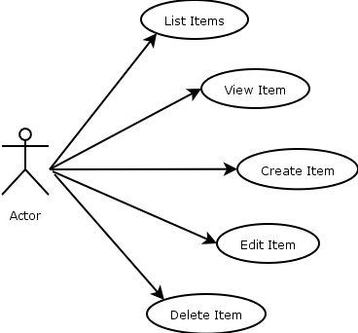
Higher Level of Detail
Notes:
Sometimes we break down into more detail.
Here a single use case might be “Manage Inventory”, but because your discussion with the client highlights the importance of the interface design for this process, you break it down into individual actions involved in managing inventory.

Slide 22
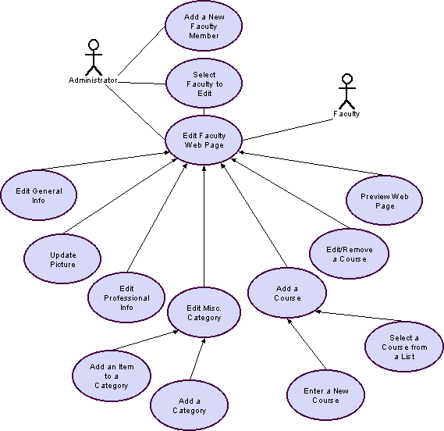
Medium Complexity Use Case Diagram
Notes:
More complex systems, or if you’re modelling at a higher level of detail will give you more complex diagrams
Here we see multiple users simultaneously for a college web site
Remember that there are detailed written descriptions that go with each use case.
These would explain, for example, what the categories are, or what professional information is involved.
They would also incorporate business rules, for example what the policy is for adding or removing a course.

Slide 23
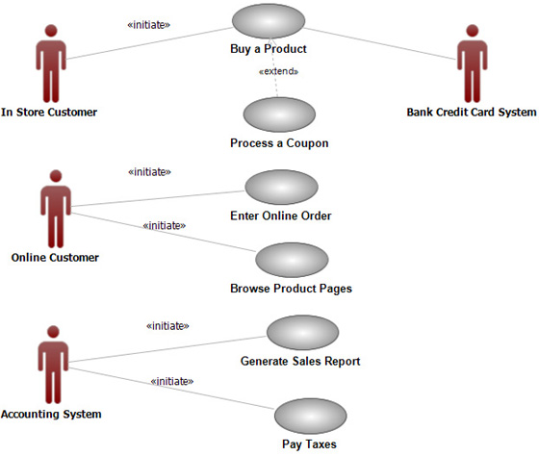
Multiple Actors
Notes:
Note that a production system will have many users (even if it has only one client)
Remember to consider them all

Slide 24
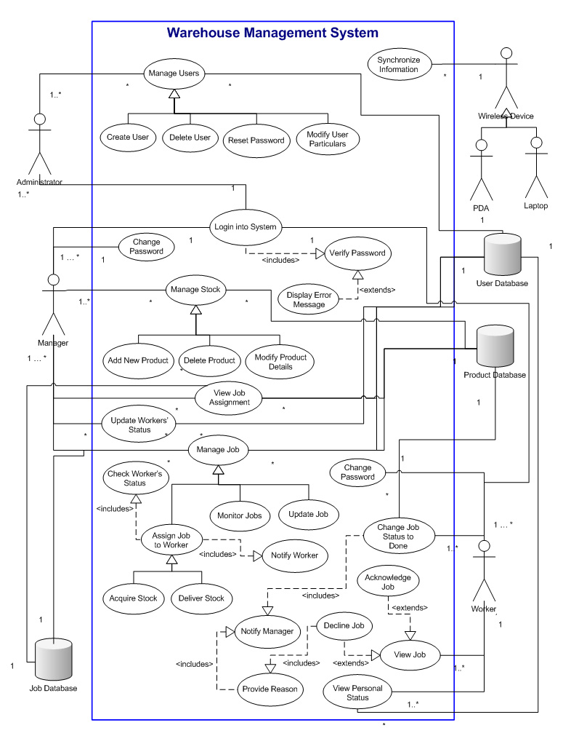
Very Complex Use Case Diagram
Notes:
Sometimes things can just get out of hand
Remember that one of the purposes of the diagram is to help the client understand your plan
This probably won’t
So generating a good use case diagram is a Goldilocks and the Three Bears problem – not too much and not too little. It has to be just right.
Sometimes you won’t realise that your diagram isn’t at the right level of detail until you discover that your client is confused (too much detail) or has a completely different notion of what they wanted (probably not enough detail along the way somewhere).
Conceptual modelling. Not easy.

Slide 25
2. Identification of Classes
After you fully understand the data universe to be represented, and the tasks to be performed, identify the things
Notes:
This usually isn’t hard to do.
Some people recommend suggesting all the nouns as entities and seeing how it goes…

Slide 26
Identification of Classes
An agricultural research lab is studying the impact of parasites on New Zealand sheep farms.
At regular intervals they visit several farms, take samples in different paddocks, and record the numbers of particular parasites they find.
The want a database that will help them to hold, analyse, interpret and understand their data.
What are the entities?
Notes:
Example:
To check, think of questions someone might ask. Can you answer them?
Farm
Parasite
Experimenter – “Is there some main effect of collector?”
Paddock – “Are all the areas of this farm equally affected?”
Visit – Why? If this isn’t an entity, we may end up recording it more than once (more about this later…..)
Region
Weather
Stock – “Does it matter what kind of critter lives in the paddock?”
….,

Slide 27
Optionality and Cardinality
Given a rough, initial data model, carefully consider the optionality and cardinality of each relationship.
This process can
Identify basic errors in the model
Generate further questions for the client to improve the accuracy and suitability of the model.
Notes:
Optionality: 0 or 1. Is it mandatory?
Cardinality: 1..n: How many can there be?

Slide 28
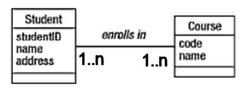
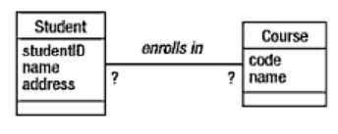
Optionality and Cardinality
Notes:
Example:
What would you put here?
The choice is tied to/determines some very integral parts about how this school works
The obvious answer is many-to-many
Each student can enrol in one or more courses, each course will have one or more students. WTP?
Any problems with this model? Any way in which the cardinality we applied may not reflect reality?
What about a new course that no one has enrolled in yet? Can it not be entered in the database? If someone does an enquiry they won’t see it. That might be very bad.
What about a student who hasn’t yet enrolled in any papers. Is he not in the database? Will he then not receive all those important emails from OPSA?
You see, by the selection of your optionality and cardinality, you have effectively defined the business rules of the school. Wrong.
What should you do to figure out the correct values?
ASK THE CLIENT

Slide 29

Optionality and Cardinality
Notes:
Remember the farm-parasite study.
Assume they have decided to record the weather conditions on each visit
This seems like a good opt/card choice: For each visit you record exactly one weather condition (e.g. rain, snow, fine, overcast…) and each weather condition may apply to 0 or more individual visits.
Any problem? Does this decision impose any assumptions on reality that might not work for us?
Yes: What if the weather is fine when they get there, but starts raining before they leave? Then they really need a 1.n relationship at the weather end.
How to decide?
In this case, we’re not so much trying to model reality truly accurately as we are trying to model the relevant aspect of reality for the client.
If most cases are stable weather, and they really don’t care about each individual sample, let it go, even though it’s not a completely accurate reflection of meteorology.

Slide 30
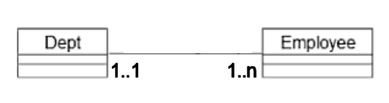
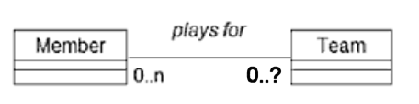
Optionality and Cardinality
Historical data
Notes:
Here, each department has one or more employees; each employee is in 1 (exactly 1) department.
I used to work at the University. I taught in the Psychology department. But then I moved to the Medical School.
How will this database cope?
When I move, you will have to replace my one associated “Department” entity with a new instance. Effectively, the fact that I ever worked in Psychology is lost forever.
But what if there is an audit and they want to know about employees some years ago? What if someone wanted to verify my employment history? I wouldn’t exist prior to my move to the medical school?
This is a common pattern in database modelling – it occurs with the need to store historical data, to persistently store data that changes over time
What would we really need here? Many to many, and a date attribute somewhere.
The precise details of how this complex relationship would translate into tables comes when we talk about logical modelling.
Here’s a similar situation. We’re giving the Team end of the relationship 0.. because someone might be a member of the league but not currently on a team. Should it be 0..1 (only ever storing Bob’s current team) or 0..n (which would allow us to keep a historical record of all the teams Bob has played for)?
Which is right? ASK THE CLIENT. Why are they associating teams and members? If it’s only to be able to call people on the roster, don’t get carried away with extra tables needed for historical data. It will only hurt your performance.
Remember, there is rarely one absolutely “correct” model. There is only the most accurate model of reality as it is relevant to what the client wants.

Slide 31
3. Entity, Attribute Or Relationship?
Entity = Thing
Attribute = Property/characteristic of thing
Relationship = Association between things
Notes:
You’ve learned about your problem, you’ve thought about all the things, you’ve thought about all the ways things are associated
It should now be pretty easy to draw entity boxes and put properties in them, and slap some lines in between them, right?
Maybe…

Slide 32

Entity, Attribute Or Relationship?
What about the team captain?
Notes:
Back to our sports club….
Say we’ve decided we only care about a member’s current team, so this is our model
What about the captain?

Slide 33
Entity, Attribute Or Relationship?
Team
Team
Name
Uniform Colour
Mascot
Grade
Captain
Name
Uniform Colour
Mascot
Grade
Captain
Captain’s Phone
Captain’s Address
…
Notes:
Perhaps Captain is an attribute of Team
But what if you want to store information about the Captain, like phone number, or address
If you stuff them all in as attributes, things can get unwieldy. And it can get worse, if, for example, you can have co-captains. Will you have Captain 1’s Phone, Captain 2’s Phone…?
Any alternative?
Well since a captain is probably a member, and your member entity already has that stuff, maybe captain isn’t an attribute at all, maybe it’s a relationship between Team and Member…

Slide 34
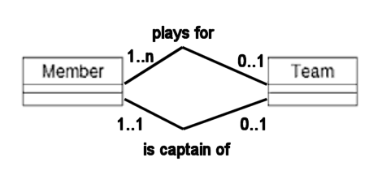
Entity, Attribute Or Relationship?
Notes:
Again, we will see how to make this into tables later.
Which you choose will determine what queries you can make, and how efficiently you can make them
Oversimplifying greatly, a more complex model will allow you to make more queries, but will run more slowly (because of the joins required to get all the multiple tables together). Again, it’s Goldilocks.
Are there any other alternatives?
Sure, we’ve tried attribute and relationship, but there’s one more: What if Captain is supposed to be an entity?
Why might we want to do that?
If there is information you need to store about Captains that you don’t need to store about non-captain members. For example, perhaps to be a captain you must have a current First Aid certificate, and we need to store the date of that?
If captains are just stored as members, then EVERY MEMBER must have a field for First Aid date that will be NULL for the majority of records, and therefore wasted space. Ew.
This issue should remind you of a similar concern in OO modelling (inheritance), and that’s exactly what it is. Is Captain a special case of Member (i.e. a subclass) with all member’s attributes, but some extra ones?
In database land, it’s called Generalisation/Specialisation

Slide 35
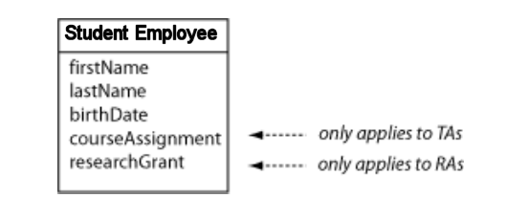
Generalisation and Specialisation
Notes:
Let’s assume we’re finally going to get some student assistants
There are teaching assistants to help in the classroom, and there are research assistants to do research grunt work, and any student can only be one or the other
If you’re a teaching assistant, we need to keep your course assignment, if you’re a research assistant, we need to keep your grant budget number.
If we have a student employee class like this, we run into all kinds of problems – wasted space, data integrity (what happens if you get a data entry error and end up with values in both? What does that mean?), complex conditionals in queries, and so on.
Because really, the situation is more accurately modelled like this….

Slide 36
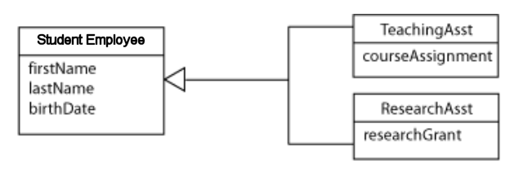
Generalisation and Specialisation
Notes:
This is specialisation
The notation is very similar to OO inheritance; the arrow denotes a parent/child or superclass/subclass relationship.
While working on your model, you may discover the need for specialisation when an entity you thought was one thing turns out to contain two distinct groups
You may also discover the need for generalisation, when what you originally thought were multiple distinct entities turn out to have some things in common…

Slide 37
Generalisation and Specialisation
Student
Paper
Is taught by
Lecturer
enrolls in
Name
Address
Programme
Paper Code
Name
Address
Salary
0..n
0..n
0..n
1..1
Notes:
Consider this ordinary sort of model (from Churcher)
Pretty simple. Students enroll in 0 or more papers; Papers are taught by one lecturer, etc.
Now the school decides to sell parking spaces to students and staff, and they need to have this in their database

Slide 38
Generalisation and Specialisation
Parking Space
Number
0..1
0..1
Is assigned to
Is assigned to
0..1
0..1
Student
Paper
Is taught by
Lecturer
enrolls in
Name
Address
Programme
Paper Code
Name
Address
Salary
0..n
0..n
0..n
1..1
Notes:
So we add a nice parking space entity – the relationship is 0..1 at both ends
Any problems?
A student or a lecturer has 0 or 1 parking spaces. Fine. But look at it reading from the top: A single parking space can be assigned to 0 or 1 students AND 0 or 1 lecturers.
If you turn this model into a database using the semi-automatic method we will see next session, you are going to end up giving the same parking to place to two people.
What can you do?
Option 1: Write a bunch of complex checking code in your front end to enforce the proper constraints
Option 2: Fix the model so that it better reflects the reality of the situation.
Ideas?

Slide 39
Generalisation and Specialisation
Is assigned
Person
Parking Space
Name
Address
0..1
0..1
Number
Student
Paper
Is taught by
Lecturer
enrols in
Programme
Paper Code
Salary
0..n
0..n
0..n
1..1
Notes:
The problem is that we are treating Student and Lecturer as different things, and they are, when you’re talking about salary and major and so on.
But they’re not when you’re talking about parking spaces. They are really just different flavours of a more general entity, “Person”
So it’s better to model this situation with a superclass “Person” who holds the common attributes. It is person who holds the parking space, and now easily it’s 1-1.
This is generalisation.
(Note that we now need specialisation to get Student and Lecturer from Person.)

Slide 40
Generalisation and Specialisation
You are writing the database for the DCC dog registration system. Non-working dogs are $80 a year, and working dogs are $21 a year.
Since we are storing different information for the two kinds of dog, should they be represented as separate entities (i.e. subclasses)?
Notes:
How about this one?
Nope, this is just different values on the same attribute. Don’t go inheritance-crazy.

Slide 41
The Problem with Inheritance for Relational DBMS
Generalisation and specialisation are powerful modelling techniques, and are often effective in clarifying relationships between entities
Unfortunately, they are not part of the relational algebra
A workaround is required when converting from the conceptual to the logical model
Use them anyway
Notes:
There is nothing in the relational model that supports inheritance at all.
When you get to the whole tables/columns/keys things, it can’t be done, at least not directly.
There are a couple of work-around approaches, that we will cover when we look at the conversion from conceptual to logical models.
This is part of the argument in favour of OO databases, but only a weak one
In conceptual modelling you should definitely use them, even though they are a little awkward to translate into a RDBMS.
Remember the goal of conceptual modelling is to capture the data universe and communicate with the client. So use them.

Slide 42
4. Verifying the Model
Compare against your use cases
Ask the client

Slide 43
Homework
For each scenario, think about:
What questions would you ask the client?
What might the use cases be?
What are the main entities?
What are their attributes?
Where are the relationships? How would you label them?
Can you assign optionality and cardinality?
Etc.
Notes:
In our next session, we will go through the process of converting a conceptual model to a logical one
We will make tables with columns, we will define keys and we will normalise (don’t worry if you don’t remember the details from DB2)
Then you will be given your modelling assignment, which you will work on during week 3.
You will be placed into groups for this assignment.
Your particular problem will be one of the set shown on the next slide.
For your homework tonight, wander around and think about these (all of them) as though you were designing a conceptual model.

Slide 44
Homework
Animal shelter Art Gallery Chess Tournaments Orchestra Dog kennel Farm management Football teams and fixtures Gaming league Help desk | Holiday cottage rental Hotel room booking system Museum Musicians in a band Pizza deliveries Vehicle details Video rentals Weddings Wildlife Park or Zoos

